Slide 1
National Sales Meeting
June 2023

Slide 2
Agenda
Goal of the day
What is SignatureMD solving for?
Homework Review
MEDDIC-F Roll out
How to move from Discovery to data pull.
Lunch
Selling the Data Analysis
Salesforce Reports – Own your Territory
Role Play: The close
Vidyard
Wrap up
Treehouse for Happy Hour
El Camino for Dinner

Slide 3
Goals of the Day
Be confident in selling the Data Analysis
Inspire your Prospects
Own your Territory
Feel Confident to Use Meddic

Slide 4
Rules
Be Present
Be Open Minded
Be Open to Feedback
Leave your ego at the door
Stay off you Cell Phones and on Silent

Slide 5
Success, is not a destination; it is a never-ending journey. It is the result of countless hours of hard work, strategic thinking, and a relentless pursuit of excellence. It is about going that extra mile, even when it seems impossible. It is about pushing boundaries, breaking barriers, and refusing to settle for mediocrity.
But remember, success is not an individual pursuit—it is a team effort. Each one of us plays a vital role in the grand tapestry of our organization. Our collective strength, knowledge, and expertise are the pillars that hold us high. Together, we can achieve greatness, inspire change, and leave an indelible mark on the world.

Slide 6
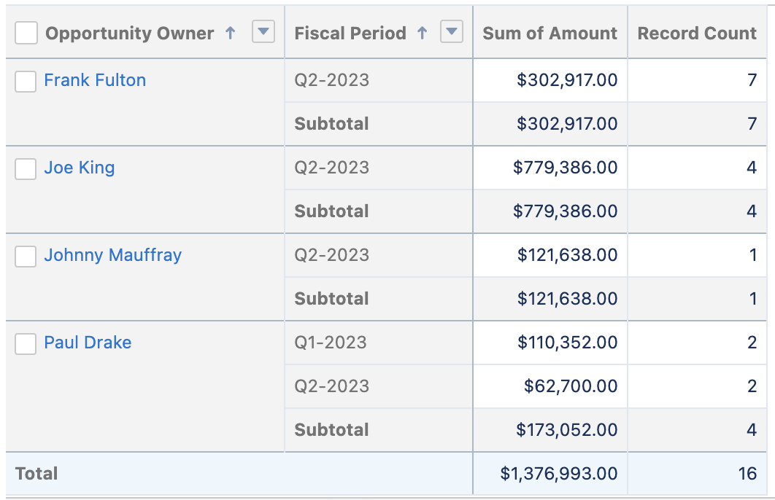
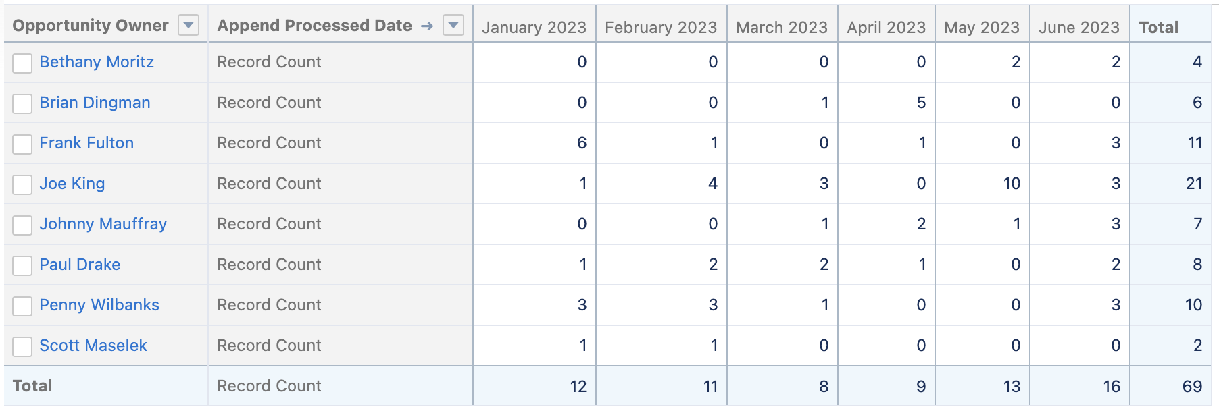
State of Union
56 is the goal we need to hit.

Slide 7
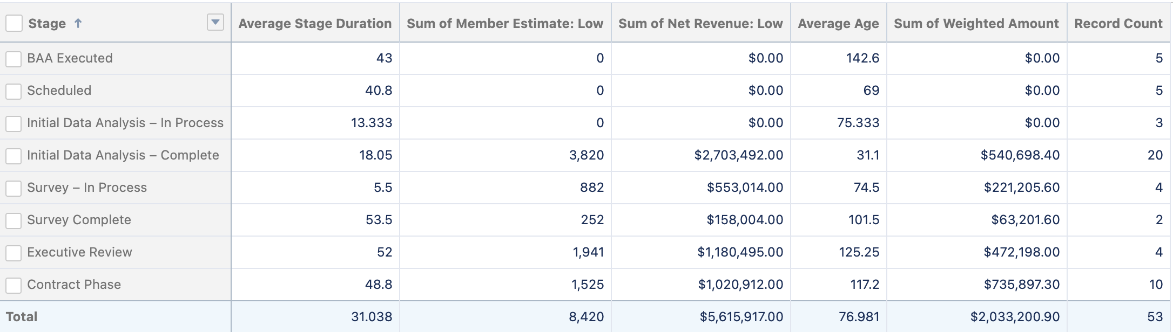
State of Union

Slide 8

What is SignatureMD Solving For?
Open Conversation

Slide 9
Why we win
Why we WIN deals: (best answer…Because that’s WHAT WE DO!)
We find the right prospects, engage them at the right time, and present the proper information based on their needs & pain points.
As a competitive advantage, we have a more “doctor centric” flexible offering (relative to our largest competitor) and can be clearly defined as such to attentive prospects.
The ability to provide a substantial signing bonus can be the one difference between a big win or a big loss.
Why we win:
*The right doctor, at the right time in his/her practice lifecycle, with defined pain points i.e. not making the same or enough money, too much admin, staff turnover, late hours, etc..
*Competitive advantage with Segmented Model vs what they’re used to in MDVIP
*Burned out – back to first point – pain points have become unsustainable.
*Our approach is more appealing and less pushy – I think this should not be overlooked as it has been told repeatedly to me.
WIN – good Rapport- understanding pain- take time to understand business – persistence – resilience- Flexible- product knowledge of industry- know your competitor- show value – show that you care.

Slide 10
Why we win
2- were absolutely ready and had been thinking about it for a long time. (Letellier and Spine)
1-he had been thinking about it for a long time but wouldn’t act and an affiliate referral and knowing me as a previous rep that called on him-pushed him to the finish line (Kretzschmar)
1-they had been looking at adding these services to their company as doctors and patients were expressing interest and I just happen to locate the inquiry to the previous rep who had not worked it and I knew the upper management so I ran with it. (THPG)
1-was a referral and had decided that she needed extra revenue in her practice and didn’t want to be bought out by any of the corp entities so she felt this would be good for her bottom line and she could slow down too. She was excited when I signed her (Jacqueline Le) but during the transition I am not sure what happened-but she was not very cooperative with the transition team and after a few weeks it was decided to shut down.
Why we WIN deals – Well, as you know, I haven’t won a deal yet, but I’m working hard to get one for sure! Dr Romanowski Hurt! How I’m moving some providers through our process is by selling the concierge article. Membership medicine is the wave of the future, and so many providers our looking into it, so why not you? And why not we SignatureMD? We are the leader the membership-based medicine. You will hear more in my Vidyard.

Slide 11
Why we lose
Why we lose:
*DIY – their colleagues have done it successfully on their own.
*No identifiable pain points – they’re making great money, have a solid system and don’t put in extra hours, etc.
*Projections too low or inaccurate to compete – I have lost two large deals due to our projections being so much lower than competition.
*We’re missing deals (not necessarily losing) to compete with MDVIP due to them not knowing about SMD or knowing there is a better option.
Why we LOSE deals: (Presuming you mean to a direct competitor)
Mediocrity across key channels of salesmanship:
Lack of consistent, timely follow up
Failure to build the personal relationship better than the competitor (spousal involvement, truly unique targeted interactions, mutual self- disclosure, etc.)
Lack in understanding the individual physician’s TRUE pain points, and inability to properly explain how we can fix them specifically.
Underusage of existing affiliates to help position and sell the model, doctor to doctor. (This is a MANDATORY component with our largest competitor)
Complacency that it is just “going to happen” because of what you feel, or have been told. There are a million reasons why a prospect can go quiet, but there is only one important reason as to why they eventually stay quiet: the competition has gotten in there and is taking your stake to the claim of a signature.
I believe we LOSE deals when we get complacent. Maybe we assume it’s in the bag and allow a competitor to get their foot in the door or stop showing up for our doctor like we did when we were first pursuing the account. We have to continue adding value to our doctors well beyond our initial interactions and after the contract is signed.

Slide 12
Why we lose
Poor understanding of needs- weak product knowledge- not enough pain- not understanding your value add-lack of trust or credibility.
Not addressing Objections fully- poor follow-up- poor qualification- not being flexible
The deals why they HAVE NOT closed-here’s the reasons why
Not emotionally ready
They are bought in but spouse or friends/family are not and wont support
Morally not able
Practice or personal issues need to work through
Contract issues (didn’t like terms)
Either a board or like Privia legal blocks
Demographics too low
Want to do a hybrid approach only and not hire a midlevel
Got a great offer of a buy out from a company

Slide 13
Why Deals Stall
STALL- lengthy decision making process-other priorities – lack of trust- not following up engagement
Why we stall:
*They’re not 100% sold. Through the sales process we did not get them emotionally locked in 100%
*Fear of change (back to above point). There are some that stall that are sold but terrified of change (Khalil)
*Stall due to needed office personnel change – need new NP, new Office mgr, etc.
*Pain points aren’t bad enough to force change
*Spouse or trusted colleague is not 100% bought in
Why deals STALL or slip – I have heard multiple times “morally and ethically” I can’t leave my patients, it’s just not the right time, every independent provider I have spoken to has mentioned some hospital group trying to buy their practice. You all know the incentives they throw at these providers. They make it very enticing for them. Dr Chakrabarti said to me he is tired of managing his practice. This was mostly about trying to hire good people. Also, multiple providers are trying to hire a qualified NP, and their having a difficult time. This is a big one for sure!
Why deals STALL or slip (disregarding the incidences where circumstances were agreeably completely out of our control)
Failure to set the timeline and expectation of each step in the process from the very first meeting with the doctor. (Hipaa-Data-Survey-Financials-Background Check-Contract publishing-legal review-final signing)
Contact with the physician that doesn’t eventually graduate to DAILY communication as contract signing gets closer.
Inability to keep the excitement level of the “new practice” in the forefront of their mind, and a top priority to achieve it as something they think about daily.

Slide 14
Break
15 Min Break

Slide 15
MEDDIC-F
Welcome to this training session on MEDDIC, a powerful sales qualification framework. MEDDIC provides a systematic approach to understanding customer needs, aligning sales efforts, and increasing the chances of closing deals successfully. In this training, we'll explore each element of MEDDIC and discuss how to effectively apply it in your sales process.
MEDDIC-F (Metrics, Economic buyer, Decision criteria, Decision process, Identify pain, Champion, and Fox)

Slide 16
MEDDIC-F
Metrics:
The first element of MEDDIC is Metrics. This refers to the quantifiable measures of success or goals that the customer wants to achieve. In this step, it's crucial to identify the key performance indicators (KPIs) or metrics that are important to your customer. Understand their business objectives and how your solution can help them achieve those objectives. By aligning your offering with their metrics, you can demonstrate the value you bring to the table.
Key points to cover:
How to identify the customer's metrics and KPIs.
How to relate your solution to the customer's metrics.
The importance of quantifying the value of your offering.

Slide 17
MEDDIC-F
Economic Buyer:
The second element of MEDDIC is the Economic Buyer. This refers to the person or group of people who have the authority to make the purchasing decision and control the budget. It's crucial to identify and engage with the economic buyer early in the sales process. Understanding their needs, priorities, and decision-making criteria is essential for successful selling.
Key points to cover:
How to identify the economic buyer.
Strategies for engaging and building relationships with economic buyers.
Understanding the economic buyer's priorities and decision-making process.

Slide 18
MEDDIC-F
Decision Criteria:
The third element of MEDDIC is Decision Criteria. This involves understanding the specific factors or criteria the customer will consider when evaluating your solution. By understanding their decision-making process, you can tailor your approach and address their concerns effectively. It's important to proactively gather information about their decision criteria and align your offering accordingly.
Key points to cover:
How to identify and prioritize the customer's decision criteria.
Techniques for gathering information about decision criteria.
Tailoring your solution to meet the customer's decision criteria.

Slide 19
MEDDIC-F
Decision Process:
The fourth element of MEDDIC is the Decision Process. This refers to the steps and stakeholders involved in the customer's decision-making process. Understanding the decision process allows you to navigate through the organization, build relationships with key stakeholders, and influence the decision in your favor. By identifying the decision-makers, influencers, and gatekeepers, you can effectively manage the sales cycle.
Key points to cover:
Mapping the decision-making process and identifying stakeholders.
Building relationships with key stakeholders.
Strategies for navigating complex decision processes.

Slide 20
MEDDIC-F
Identify Pain:
The fifth element of MEDDIC is to Identify Pain. This involves understanding the customer's pain points, challenges, or problems that your solution can address. By demonstrating a clear understanding of their pain points, you position yourself as a trusted advisor who can provide valuable solutions. Probing questions and active listening are crucial in uncovering and understanding the customer's pain.
Key points to cover:
Techniques for uncovering customer pain points.
Active listening and effective questioning strategies.
Linking your solution to the customer's pain points.

Slide 21
MEDDIC-F
Role Play: Pain Point

Slide 22
MEDDIC-F
Champion:
The final element of MEDDIC is the Champion. This refers to a key individual within the customer organization who supports and advocates for your solution. Having a champion can significantly increase your chances of success. It's important to identify and nurture champions throughout the sales process, as they can help you navigate the organization, address concerns, and influence the decision.
Key points to cover:
How to identify and build relationships with champions.
Leveraging champions to influence the decision.
The role of champions in driving successful sales.

Slide 23

MEDDIC-F
FOX:
The additional element of MEDDIC is the FOX. This refers to a key individual within the practice or their close friends and family who will try to tank your deal. There is always someone within the practice can significantly decrease your chances of success. It's important to identify the FOX throughout the sales process, as will want to address concerns, and influence the decision.
Key points to cover:
How to identify and build relationships with the FOX
Leveraging champions to influence the FOX.
The role of FOX in killing your deal

Slide 24
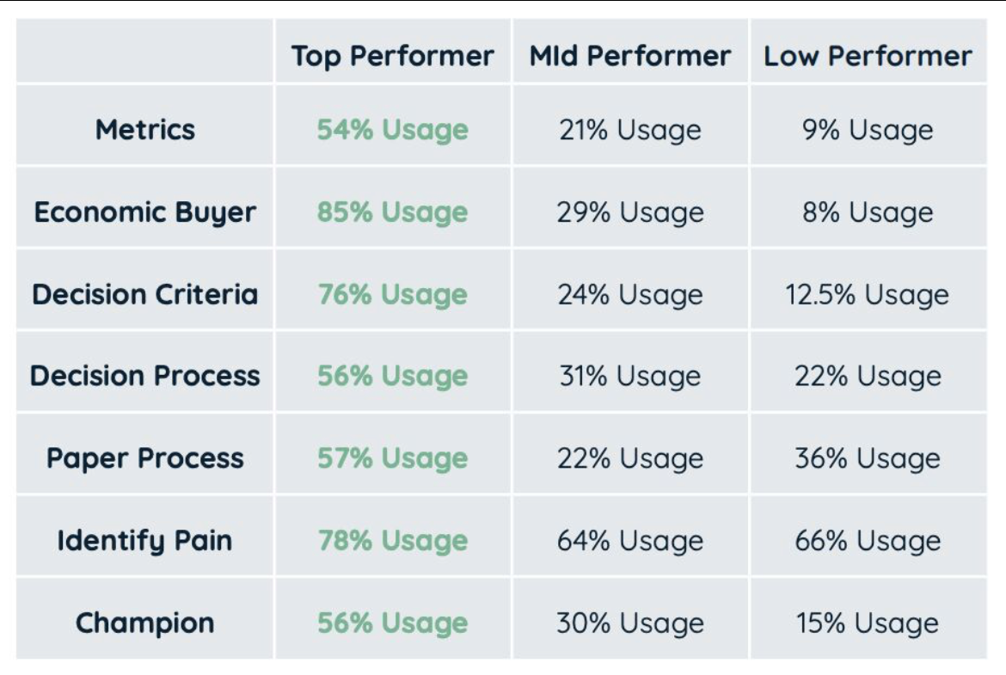
MEDDIC-F
In terms of the data in this screenshot it is taken from the Ebsta Benchmark Report that has analysed $37B worth of annualised pipeline and 3.2M opportunities, so its very robust research.

Slide 25
MEDDIC-F – Discussion
Open Discussion

Slide 26
Lunch
30 min break

Slide 27
From Discovery to BAA
66 Discovery Meetings set alone from the inside team. Less than 10 have gone to BAA and Data Pull.
What we need to accomplish in this session:
Feedback for the inside team. How do we go from Good to Great?
What we need to say to earn the right to review their data?

Slide 28

Role Play – Selling the Data Analysis

Slide 29
Break
15 Min Break

Slide 30
Salesforce – Building Reports
List Views
Reports

Slide 31
Role Play – Review Data
Review one of your prospects data

Slide 32
Getting the win – What is your approach to having a prospect say yes!

Slide 33


Slide 34
Key Take Aways

